Slide 1
Math is fun, it teaches you life and death information, like when you're cold, you should go to a corner since it's 90 degrees there.

Slide 2
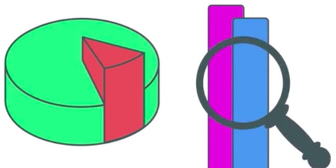
Data Science 101
Day 3: Basic Mathematics

Slide 3

About Me
Join us: https://www.linkedin.com/groups/6707800/
Twitter: https://twitter.com/Sanjeet36284331
Linkedin: https://www.linkedin.com/in/sanjeetshukla/
Sanjeet Shukla
Data Scientist-Big Data
Cognizant Technology Solutions

Slide 4
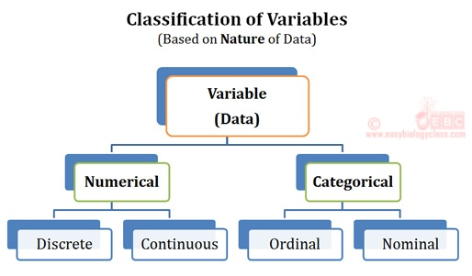
Variables
A variable is a quantity whose value changes.
A random variable is a variable whose value is a numerical outcome of a random phenomenon. Like rolling a dice, tossing coins etc.

Slide 5
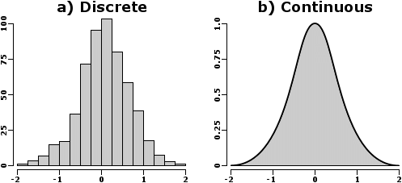
Continuous & Discrete Variable
Discrete variable can take a finite number of value between two specified values.
Continuous variable can take on any value between two specified values.

Slide 6
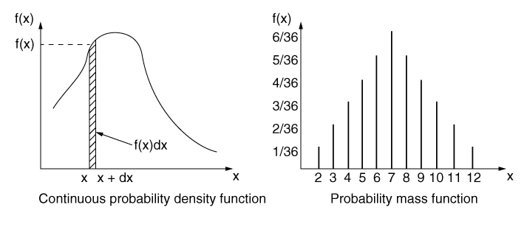
Probability Distribution
Probability distribution is a mathematical function that provides the probabilities of occurrence of different possible outcomes in an experiment.

Slide 7
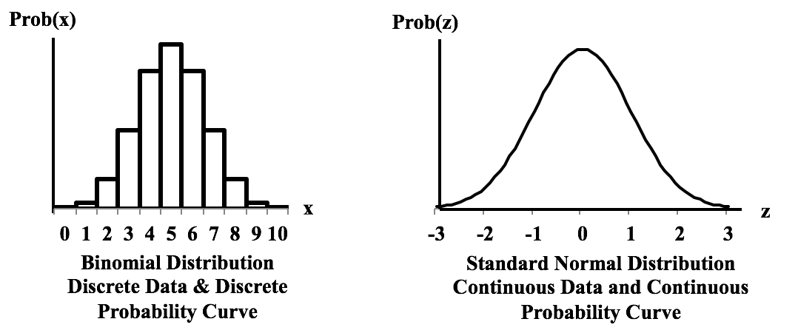
Probability Distribution

Slide 8
Population vs Sample
A population includes all of the elements from a set of data.
A sample consists one or more observations drawn from the population.
A sampling method is a procedure for selecting sample elements from a population. Simple random sampling refers to a sampling method that has the following properties.
The population consists of N objects.
The sample consists of n objects.
All possible samples of n objects are equally likely to occur.
Note: Statistical analysis is not appropriate when non-random sampling methods are used.

Slide 9
Sampling With and Without Replacement
When a population element can be selected more than one time, we are sampling with replacement.
When a population element can be selected only one time, we are sampling without replacement.
When sampling with replacement, sample size can be greater than population size.
And the population mean is a parameter; the sample mean is a statistic.

Slide 10
Mean, Median and Mode
The mean, median and Mode are summary measures used to describe the most "typical" value in a set of values. Statisticians sometimes refer to the mean and median as measures of central tendency.
Population mean = μ = ΣX / N
Sample mean = x = Σx / n
To find the median, we arrange the observations in order from smallest to largest value. If there is an odd number of observations, the median is the middle value. If there is an even number of observations, the median is the average of the two middle values.

Slide 11
Effect of Changing Units
Sometimes, researchers change units (minutes to hours, feet to meters, etc.). Here is how measures of central tendency are affected when we change units.
If you add a constant to every value, the mean and median increase by the same constant. For example, suppose you have a set of scores with a mean equal to 5 and a median equal to 6. If you add 10 to every score, the new mean will be 5 + 10 = 15; and the new median will be 6 + 10 = 16.
Suppose you multiply every value by a constant. Then, the mean and the median will also be multiplied by that constant. For example, assume that a set of scores has a mean of 5 and a median of 6. If you multiply each of these scores by 10, the new mean will be 5 * 10 = 50; and the new median will be 6 * 10 = 60.

Slide 12
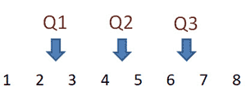
Measuring Variability
Range = Xmax – Xmin
Interquartile Range (IQR) = Q3 - Q1
Q1 is the "middle" value in the first half of the rank-ordered data set.
Q2 is the median value in the set.
Q3 is the "middle" value in the second half of the rank-ordered data set.
Q2 is the median of the entire data set - the middle value
Q1 = (2 + 3)/2 or Q1 = 2.5
Q3 = (6 + 7)/2 or Q3 = 6.5.

Slide 13
Variance
In a population, variance is the average squared deviation from the population mean, as defined by the following formula:
σ² = Σ ( X_{i} - μ )² / N
Sample Variance
s² = Σ ( x_{i} - x )² / ( n - 1 )

Slide 14
Standard Deviation
The standard deviation is the square root of the variance. Thus, the standard deviation of a population is:
σ = sqrt [ σ² ] = sqrt [ Σ ( X_{i} - μ )² / N ]
Sample Standard Daviation
s = sqrt [ s² ] = sqrt [ Σ ( x_{i} - x )² / ( n - 1 ) ]

Slide 15
Effect of Changing Units
If you add a constant to every value, the distance between values does not change. As a result, all of the measures of variability (range, interquartile range, standard deviation, and variance) remain the same.
On the other hand, suppose you multiply every value by a constant. This has the effect of multiplying the range, interquartile range (IQR), and standard deviation by that constant. It has an even greater effect on the variance. It multiplies the variance by the square of the constant.

Slide 16
Measure of Position
Percentiles: An element having a percentile rank of P_{i} would have a greater value than i percent of all the elements in the set. Thus, the observation at the 50th percentile would be denoted P₅₀, and it would be greater than 50 percent of the observations in the set. An observation at the 50th percentile would correspond to the median value in the set.
Quartiles

Slide 17
Standard Scores (z-Scores):
A standard score (aka, a z-score) indicates how many standard deviations an element is from the mean. A standard score can be calculated from the following formula.
z = (X - μ) / σ
Here is how to interpret z-scores.
A z-score less than 0 represents an element less than the mean.
A z-score greater than 0 represents an element greater than the mean.
A z-score equal to 0 represents an element equal to the mean.
A z-score equal to 1 represents an element that is 1 standard deviation greater than the mean; a z-score equal to 2, 2 standard deviations greater than the mean; etc.
A z-score equal to -1 represents an element that is 1 standard deviation less than the mean; a z-score equal to -2, 2 standard deviations less than the mean; etc.

Slide 18
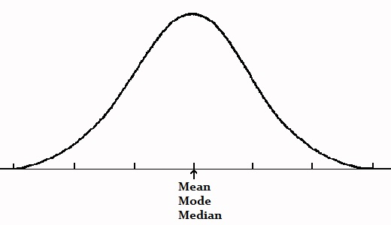
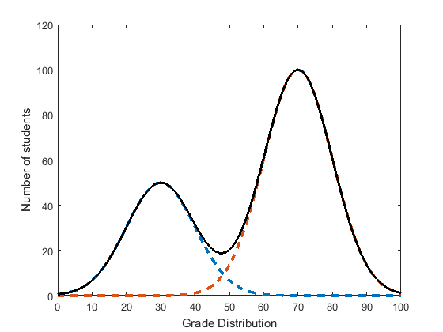
Data Patterns
Symmetric:
Number of peaks: Unimodal, Bimodal
Bimodal: One major implication of a bimodal data set is that it can reveal to us that there are two different types of individuals represented in a data set.

Slide 19
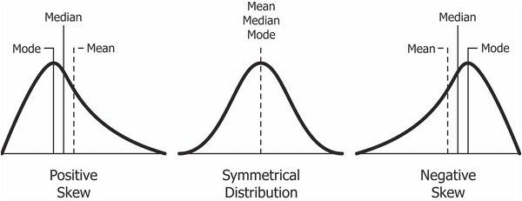
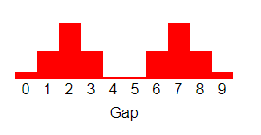
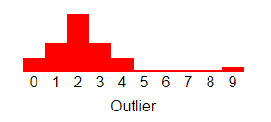
Skewness:
Gaps:
Outliers:

Slide 20
Kurtosis
Kurtosis is a statistical measure that defines how heavily the tails of a distribution differ from the tails of a normal distribution. In other words, kurtosis identifies whether the tails of a given distribution contain extreme values.

Slide 21
Additional Reading
https://mathinsight.org/probability_density_function_idea
https://codeburst.io/2-important-statistics-terms-you-need-to-know-in-data-science-skewness-and-kurtosis-388fef94eeaa
https://stats.stackexchange.com/questions/69744/why-at-all-consider-sampling-without-replacement-in-a-practical-application

Slide 22


